Slide 1

PROCEDURAL ART
LECTURE 3 – Editor Scripting in Unity
(... and how it relates to Procedural Content Creation ...)
Notes:
General welcome…
Little bit about procedural art, but mostly editor scripting and how it relates to procedural content generation.
But also outside of procedural content generation, I think this is a very nice addition to your toolbox as engineers, but also for designers and artists, these things are very valuable to know.

Slide 2
Lecture Overview
What is Editor Scripting?
In general
Examples & inspiration (most of which will be on Blackboard later)
Different categories of editor scripting
Editor Scripting in the context of the procedural art course
For what can/would/should you use it?
Do you really need it?
Getting started with Editor Scripting yourself:
Basics of Editor scripting
Extending the inspector
Adding information and interaction to the scene view
Two exercises
TL;DR; after the lecture:
You will be able to make your own designer-friendly(ish) waypoint system
Editor Scripting Cookbook & other examples (mostly (all?) from Hans Witchman)
Recommended projects to start with: stacking tool, building plot, polygon tool, view switcher
Recommendations for other resources to check out if you’re interested

Slide 3
What is Editor Scripting?

Slide 4
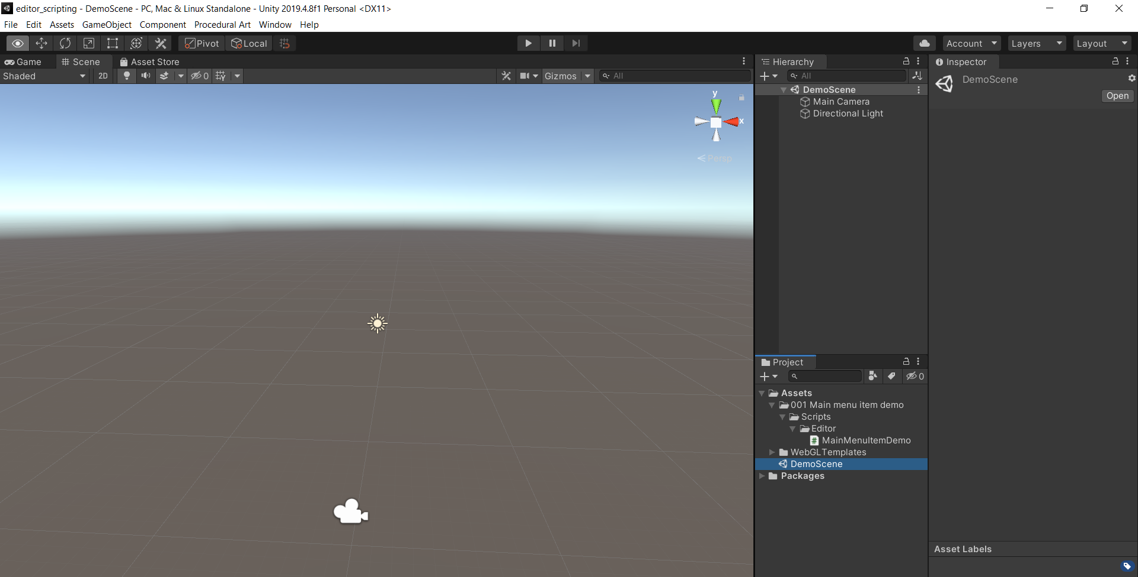
Editor Scripting in general
(Almost) everything you see and can do at Editor time is implemented or can be replicated through editor scripting:

Slide 5
Editor Scripting examples

Slide 6
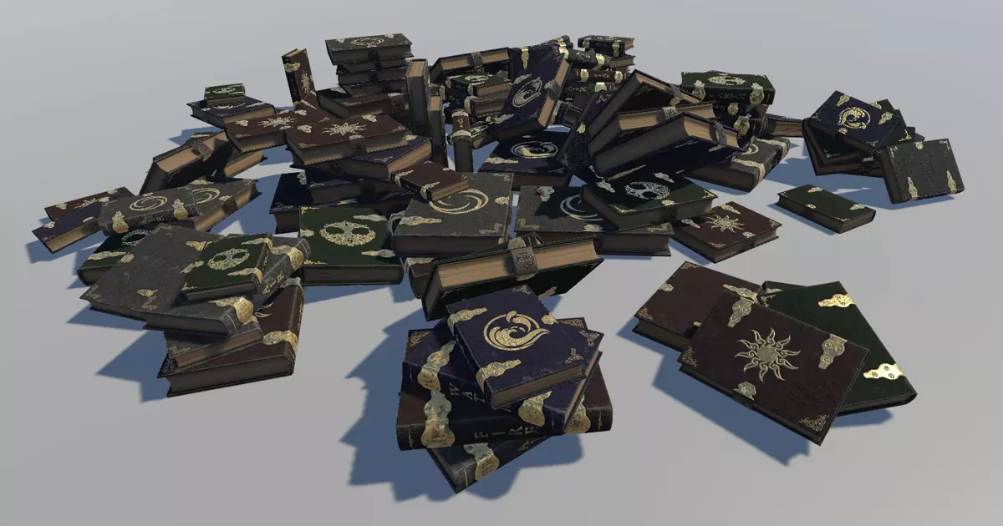
Stacking tools (by Hans)
Simple goal: easily create stacks of objects
Demonstrates:
Custom inspector
Scene interaction (could be better)
That it is not editor time or runtime, but both
Lack of undo ;)
Variety/variability
Procedural part:
Stacking objects automatically
Finding mesh bounds
Where can you find it?
Full version available on blackboard (including the books ☺)
https://assetstore.unity.com/packages/tools/utilities/stacking-tools-112062 (free, without books)

Slide 7
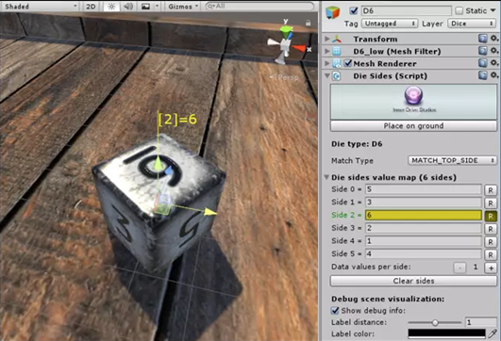
Dice Creator Pack (by Hans)
Goal: be the best dice pack on the asset store ;)
Demonstrates:
Custom inspectors (generating side normals)
Scene interaction (showing side normals)
Processing all assets in batch (Generating material sets)
Custom windows (Circle layout, Side editors)
Custom utilities (Screenshot generator)
Procedural part:
Finding die sides, aligning with ground, layouting, taking screenshots: all things you could do manually
Where can you find it?
Lite version with all scripts available on blackboard
https://assetstore.unity.com/packages/3d/props/dice-creator-pack-128640 (paid)
Notes:
Use EditorScripting to try and reduce as much repeating manual labour as possible.

Slide 8
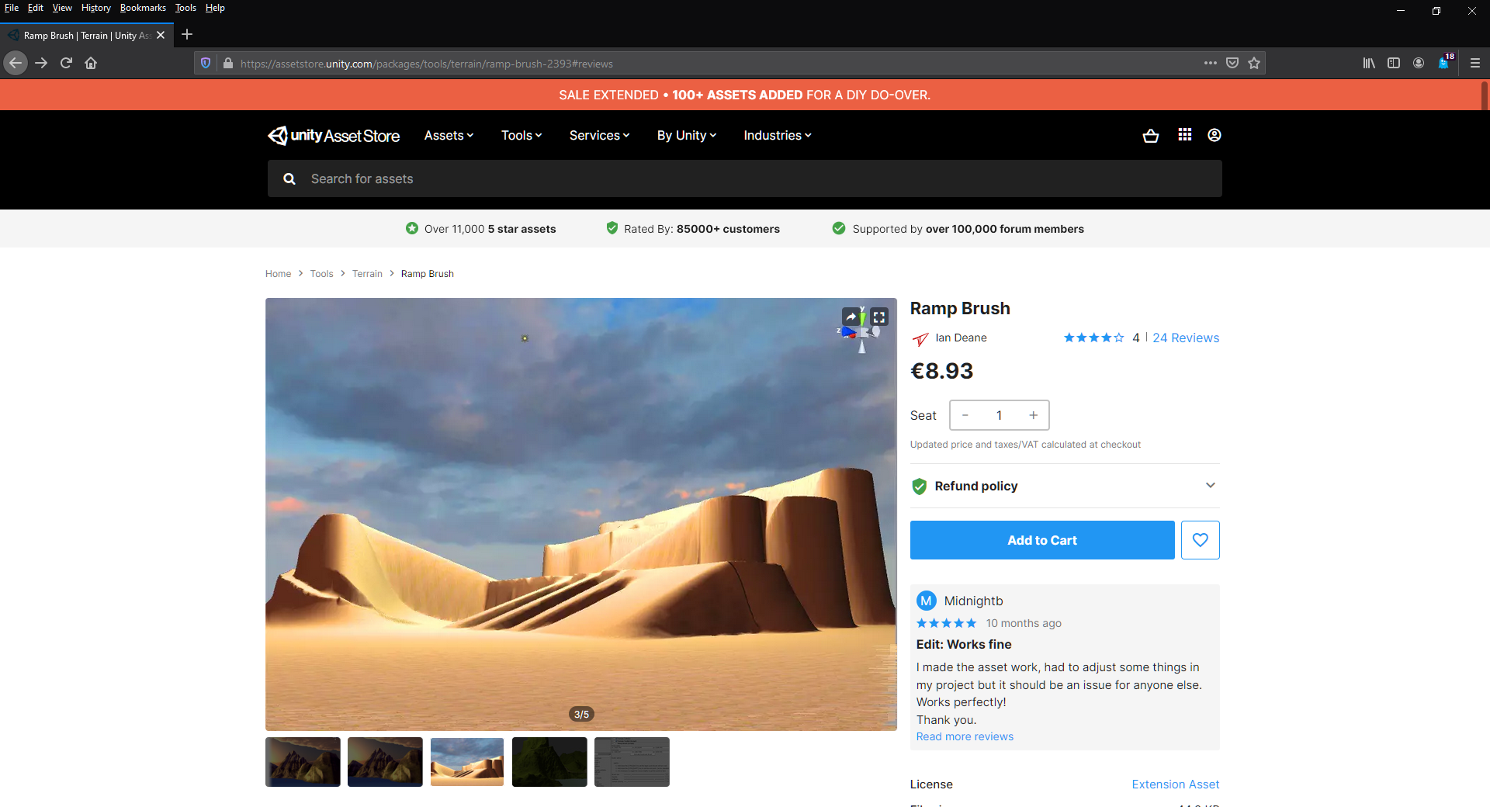
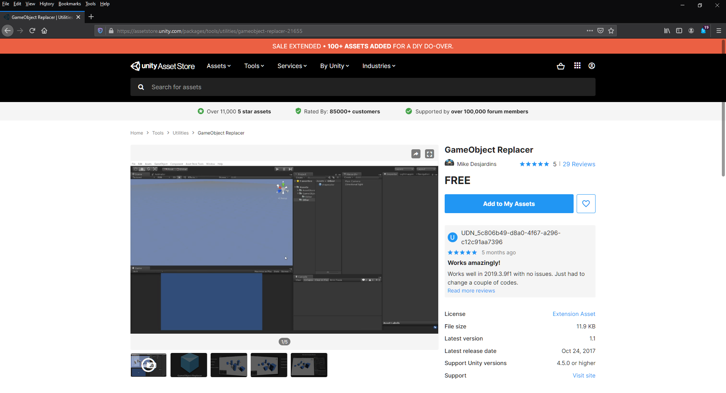
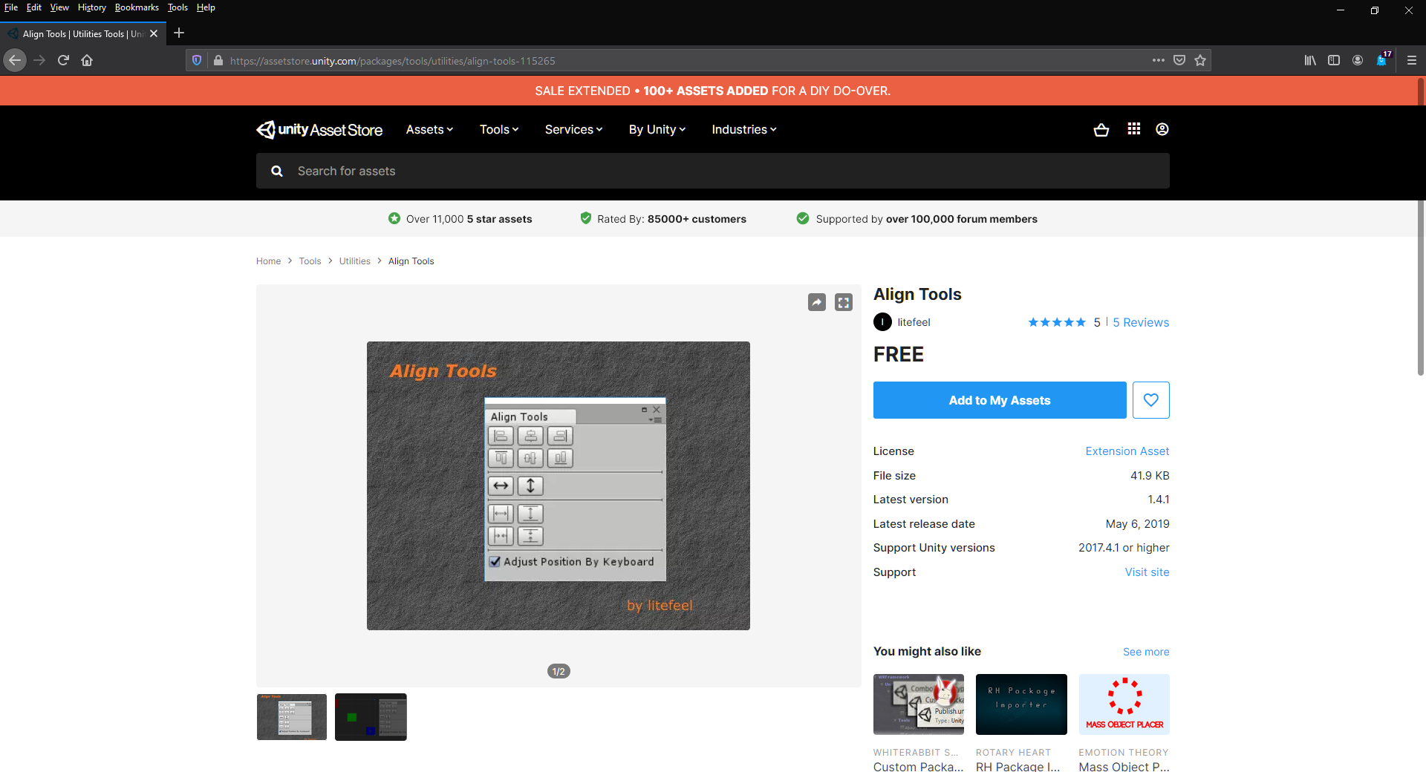
Etcetera etcetera ...
Notes:
Tools to make ramps while you are editing your terrain, tools to replace all instances of a prefab with another, tools to align objects, tools to create automatic LODS, tools to bake and optimize meshes etc.

Slide 9
Summing up: Editor Scripting is AweSoMe \^^\/oO\/^^/
Editor Scripting has a lot of different capabilities/application areas
Trigger things in your code that were already there, making your runtime adventures editable
Build simple utilities for things you could already do manually, but now much faster (eg Texture Importing, but also aligning objects, replacing prefabs, stacking objects, processing your whole scene, etc, etc)
Build complicated new features into Unity that weren't there before (eg ProBuilder, ProGrid and a lot of other packages/assets)
All these different types of capabilities can be divided in a couple of different categories of Editor Scripting
Creating (context) menu items
Creating custom inspectors / propertydrawers
Creating Scene/Editor extensions
Implementing Asset processing
... and much more ...

Slide 10
Editor Scripting ...
... in the context of procedural art

Slide 11

How does this relate to Procedural Art?
You can generate content at run time, but Editor Scripting makes it possible to do the same at Editor time
Editor time content can be saved, optimized and processed in different ways (eg think of light baking, occlusion baking, navmesh baking, etc)
It is basically another tool in your toolbox, to do things that you couldn't do before or do things that you already did before but now easier.
Do we reaaally need it?
Well, not always, buuut...
as one tutorial put it: "Editor scripting is like a wheel barrow"
It is not absolutely required, but it sure is handy
Nah, I'm good!
Would you like a wheel barrow ?
Notes:
What if we do not use editor scripting?
Runtime execution
No optimization
Long wait times
Copy paste content
Manual labor
Work is too much ->
Less options/less content/less results in a given timeframe
failed assignments
work goes to someone else

Slide 12

However, Editor Scripting comes at a 'price'
Documentation is not always easy to find
Layout can be a pain
Unity keeps changing (target, targets, SerializedObjects, IMGUI, UIElements, to name a few)
You often find new / better ways by accident or through Google instead of through the official Unity documentation
In other words the price is: time & frustration
Which means that you have to ask yourself:
Is the automation of the task I have in mind worth this time & frustration?
That depends for example on whether the result
saves a lot of time
is going to be used often
will teach you valuable skills you can monetize or enjoy in itself
can be sold (e.g. on the asset store)
comes with other benefits (e.g. study points)

Slide 13
Editor Scripting Part 1
What makes a script an Editor script?
Your first steps as Editor scripter

Slide 14
What makes a script an Editor script?
An Editor script is any script that extends or uses any class from the Editor namespace
I hope these look familiar:
using UnityEngine; ➔ UnityEngine.dll
using UnityEngine.UI; ➔ UnityEngineUI.dll
using UnityEditor; ➔ UnityEditor.dll

Slide 15
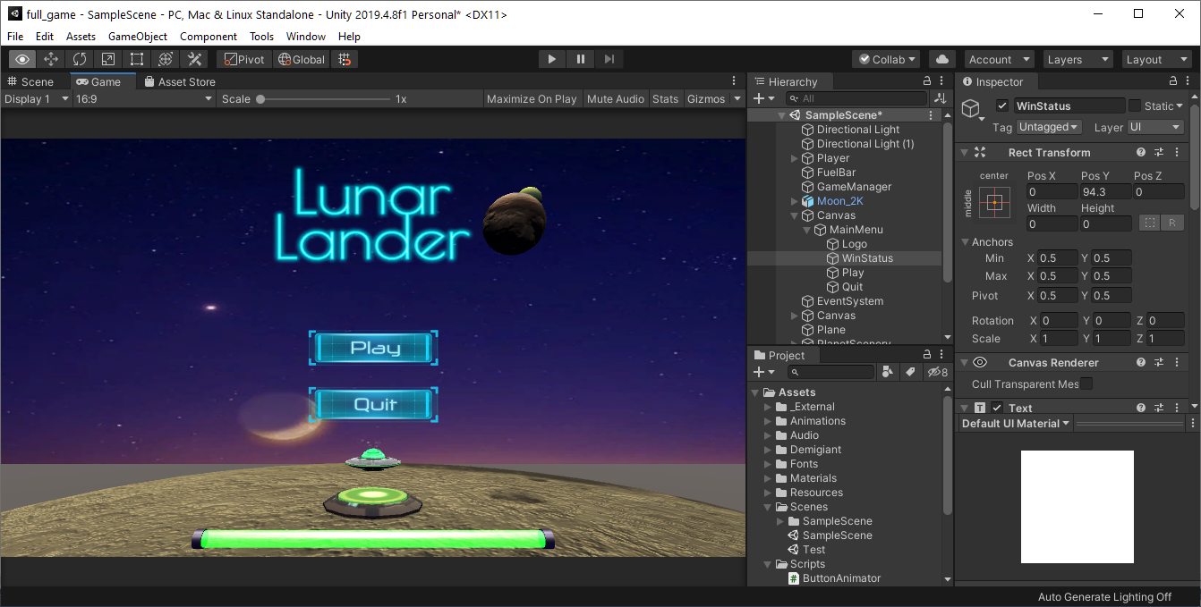
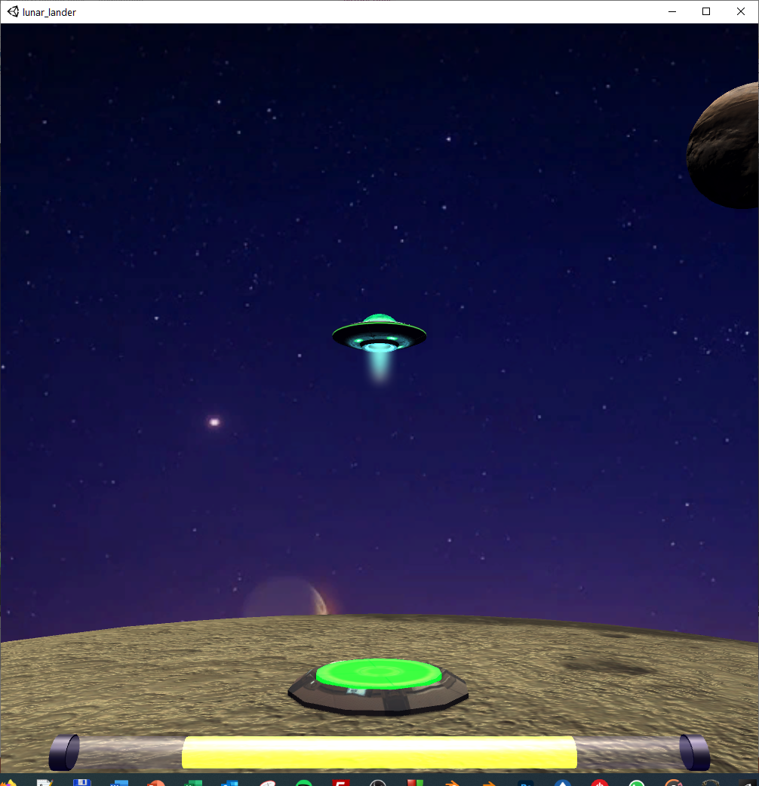
Available Unity namespaces in the Editor vs a build
In editor: In build:
UnityEngine + UnityEditor UnityEngine + UnityEditor
Notes:
This makes sense, since we have no editor in a build so we also don't have an editor namespace.

Slide 16
But this has some implications for your project structure...
All Editor scripts use the UnityEditor namespace by definition
The UnityEditor namespace with all its classes is not available in your build
Scripts using this namespace cannot run in build and therefore must be prevented from being included in your build
Unity's solution:
All editor scripts must be in a folder called 'Editor' (You can have as many Editor folders in your projects as you want in any location)
Unity automatically excludes all files in all Editor folders from your build

Slide 17
The basics of Editor scripting

Slide 18
Where did my Update() go? ☹
Editor scripts are not MonoBehaviours
This means you cannot use Awake, Start, Update (which means no Input), StartCoroutine…
Makes all time-based things harder
We do have OnEnable and OnDisable! Called when selecting/deselecting objects and when recompiling
Unity redraws the interface whenever necessary; only when the user does something (unpredictable)
It uses the ‘Event’ class for this
Mouse, Keyboard, but also some internal events
More on this later

Slide 19
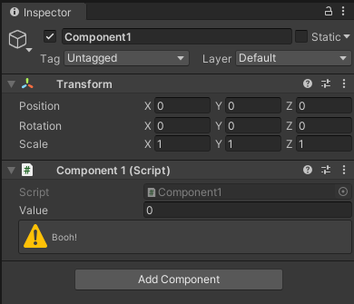
Custom inspectors
Use case:
we have a custom Component1 ...
.. and we would like to change how this default inspector behaves
using UnityEngine;
public class Component1 : MonoBehaviour
{
public int value = 0;
}
Notes:
Could be for any reason, maybe you want to store more information, add functionality.

Slide 20
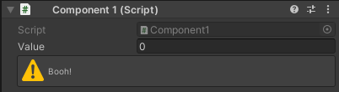
The basic structure of a custom Editor script:
using UnityEditor;
[CustomEditor(typeof(Component1))]
public class Editor1 : Editor
{
public override void OnInspectorGUI()
{
base.OnInspectorGUI();
//(same as DrawDefaultInspector();)
EditorGUILayout.HelpBox("Booh!", MessageType.Warning);
}
}
UnityEditor namespace required for Editor class (and other stuff ...)
Which component this is a custom Editor for is specified through the CustomEditor class attribute.
The class name of your editor does not matter as long as your class extends the Editor class.
Override this method to implement your own UI.
Call this method to reuse the default UI.
One of the many methods you can call to add your own stuff.
Notes:
Probably not necessary to show the demo for this one in Unity, but it’s there anyway.

Slide 21
IMGUI (Immediate Mode Graphical User Interface):
The oldest UI, useable directly from code in for example OnGUI, OnInspectorGUI
Works in game (GUI & GUILayout) and editor (GUI, GUILayout, EditorGUI, EditorGUILayout classes)
In most situations, you use either EditorGUILayout or GUILayout, tinker, search, tinker some more.
If needed, check the API documentation for these classes:
https://docs.unity3d.com/ScriptReference/GUI.html
https://docs.unity3d.com/ScriptReference/GUILayout.html
https://docs.unity3d.com/ScriptReference/EditorGUI.html
https://docs.unity3d.com/ScriptReference/EditorGUILayout.html
 | Game & Editor (OnGUI) | Editor only (OnInspectorGUI)
Manual layout | GUI | EditorGUI
Auto layout | GUILayout | EditorGUILayout

Slide 22
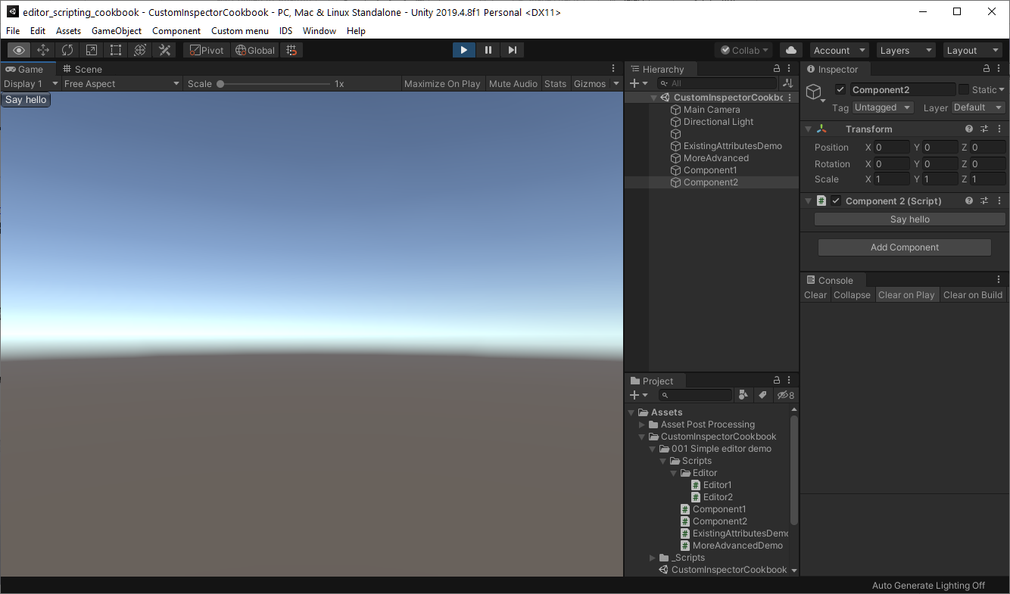
Adding a Button using IMGUI
using UnityEngine;
public class Component2 : MonoBehaviour
{
private void OnGUI()
{
if (GUILayout.Button("Say hello"))
{
Debug.Log("Hello!");
}
}
}
using UnityEditor;
using UnityEngine;
[CustomEditor(typeof(Component2))]
public class Editor2 : Editor
{
public override void OnInspectorGUI()
{
if (GUILayout.Button("Say hello"))
{
Debug.Log("Hello!");
}
}
}
Notes:
Both draws the button and checks whether it has been pressed
These are not GameObjects like you’re used to
Show demo in Unity

Slide 23
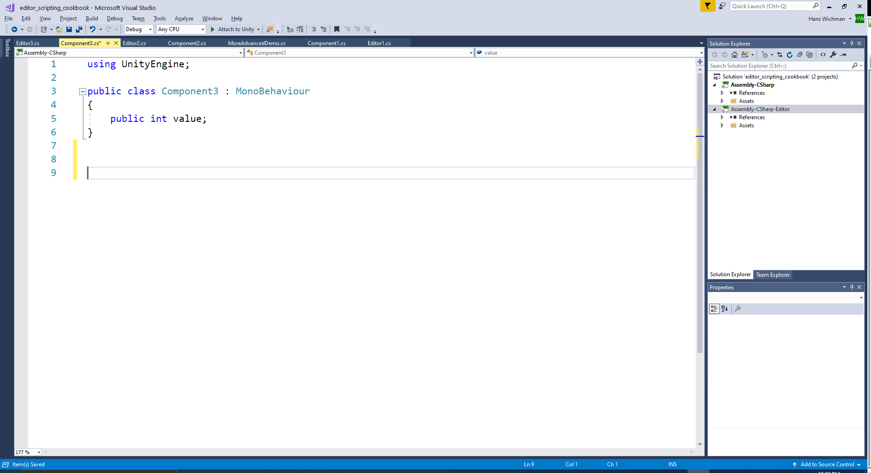
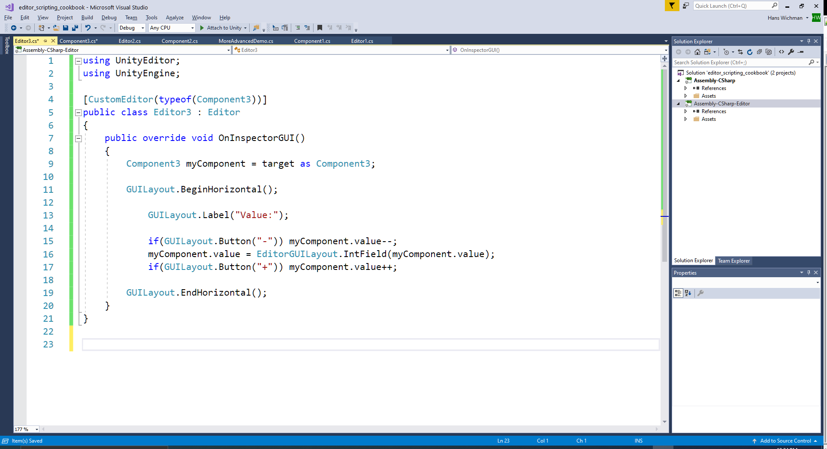
Accessing a component instance using the target property
Target property is available in every Editor script and refers to an instance of the component you are editing.
Using target is easy and quick but has some caveats:
changes are not saved
there is no undo
doesn't support multi object editing
doesn't handle prefab overrides
Notes:
Show demo in Unity; also show that stuff isn’t saved and there is no Undo (as we’ll add these later)

Slide 24
Exercise
Make exercise 1.1
Open the CurveEditor script
Add a button to the inspector that, when pressed, calls the ‘Apply’ method on the Curve object you are inspecting
The rest of the inspector should still be drawn
Read through the script and make sure you understand the non-Editor scripting stuff
Notes:
Exercise is also in Word handout
The Curve is in the CurveScene

Slide 25
Editor Scripting Getting Started Part 2
Respecting your teammates (a.k.a. adding usability)

Slide 26
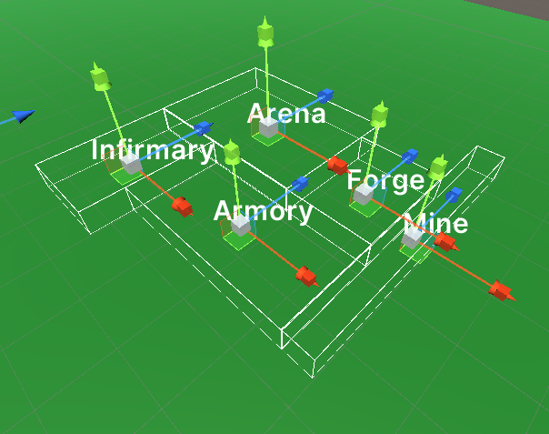
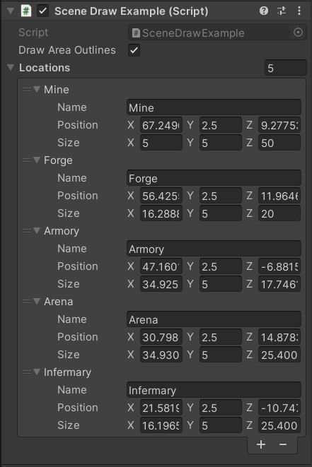
Extending the Scene view
We can draw all kinds of elements in the Scene view:
Passive elements
‘Informative shapes’
Text
Interactive elements
Position
Rotation
Scale
And many others
We can even draw a few things in play mode!
Notes:
Demo (SceneDrawingExample) is quite bad codingwise, mostly meant to illustrate the use of Gizmos, Debug and Handles.
When entering play mode there should be debug lines drawn (make sures to have Gizmos enabled as in first image)

Slide 27
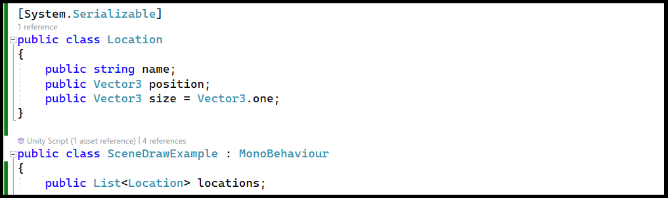
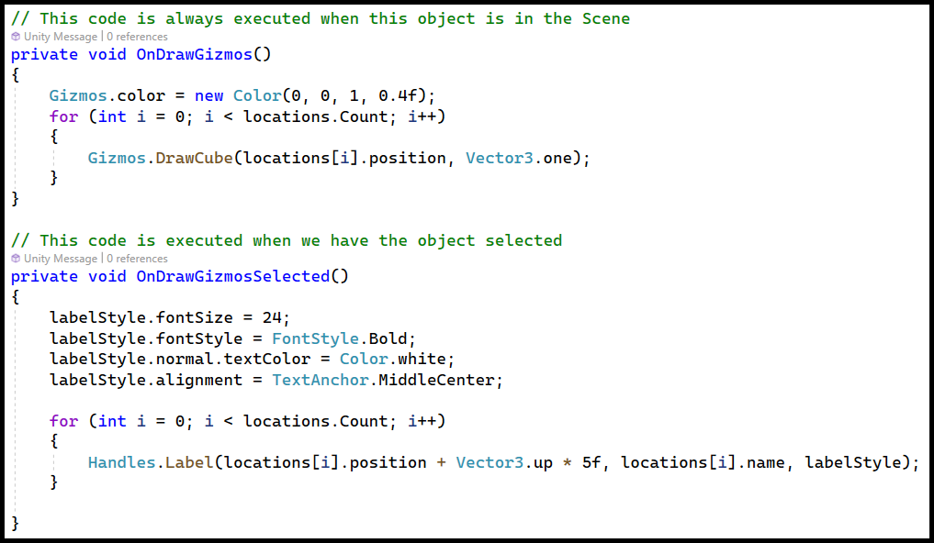
Extending the Scene view
We can add Gizmo functions to MonoBehaviours.
Gizmos allows us to add many different shapes to the scene
Can be added directly to your MonoBehaviours
Different functions
OnDrawGizmos
OnDrawGizmosSelected
[DrawGizmo]
Passive elements
OnDrawGizmos always draws when the object is in the Scene.
OnDrawGizmosSelected only draws when the object is selected in the Hierarchy.
The Handles class allows us to draw text into the scene

Slide 28
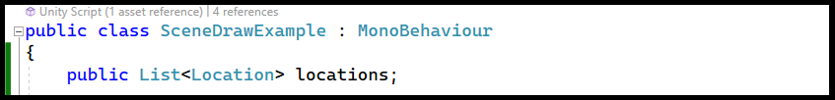
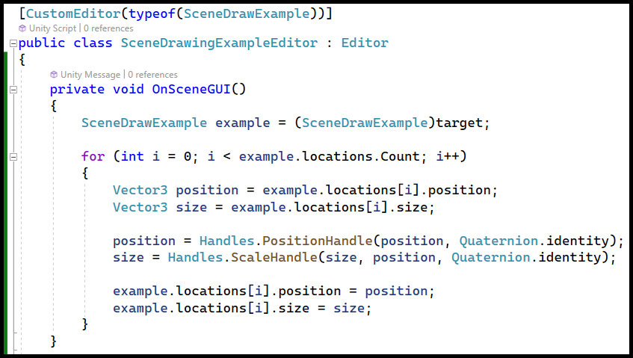
Extending the Scene view
We would like to draw interactive handles for the locations.
Handles allows us to draw interactive elements
Position, rotation, scale
Many others, check the documentation
Only works in the Scene view
To draw interactive elements, we need to make an editor script.
To draw in the scene, we need to call OnSceneGUI().
Using the Handles class, we can draw many different interactive elements. Like we saw earlier with the GUILayout.Button, these calls both draw the element and return a value

Slide 29
Extending the Scene view
Summarizing:
Multiple ways to add information to the scene
Gizmos
Debug
Handles
Depending on ‘where’ and ‘when’ it should be drawn, different classes apply
Debug (mostly) in Play mode
Gizmos can be added to MonoBehaviours in specific functions
Most Handles functions add interaction and should be added to Editor scripts

Slide 30
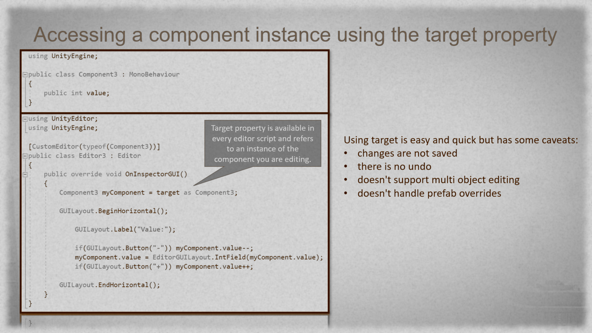
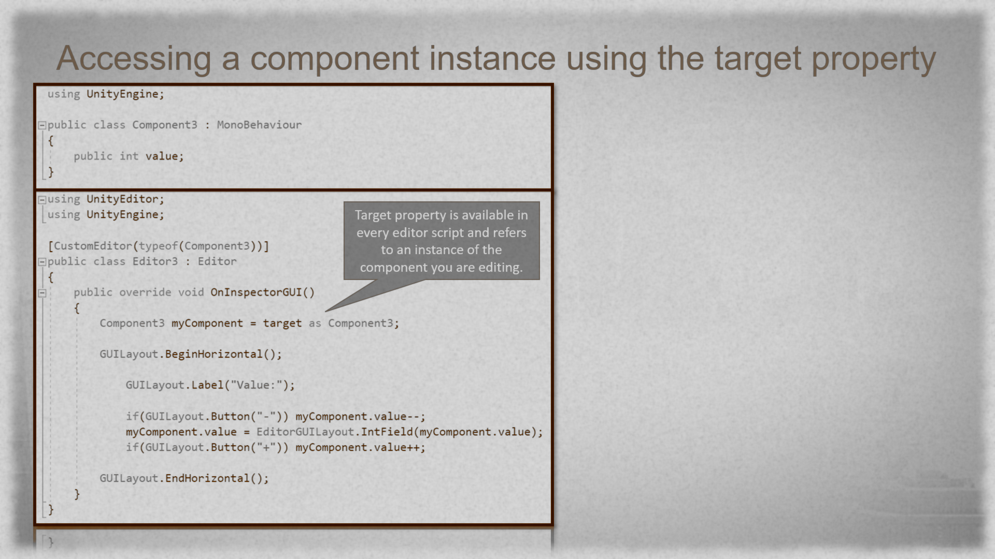
Remember this slide?
Notes:
There’s some stuff hidden behind the image, so look at this one in presentation mode ☺
Here we explain that we are going to fix the undo and saving issue that target has

Slide 31
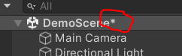
Dirtying the scene
When making changes in the scene, Unity marks the scene as ‘dirty’
Doesn’t automatically happen if we make changes through using ‘target’
Solution: Detect changes and dirty the scene explicitly
EditorGUI.BeginChangeCheck
When you make GUI changes
Write your own ‘detection’ code
In other cases, much simpler than it sounds
EditorSceneManager.MarkSceneDirty or EditorUtility.SetDirty
Notes:
I would use the SceneDrawingExampleEditor to display how to do this, using EditorGUI.BeginChangeCheck/EndChangeCheck
Might be good to also show it with Component3, cause there you can’t use EditorGUI.BeginChangeCheck/EndChangeCheck, to show that there are alternative ways to detect changes

Slide 32
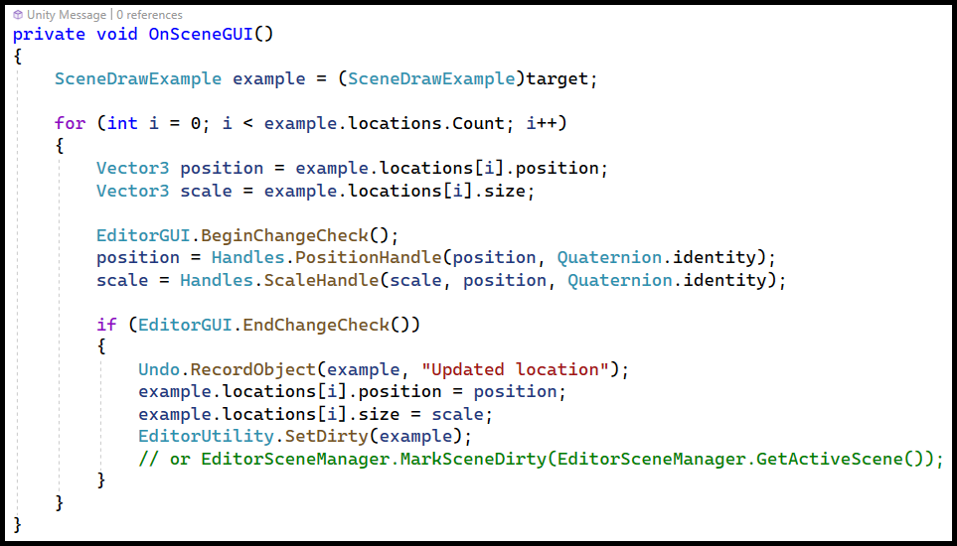
Detecting changes with EditorGUI
Before adding interactive elements to the scene, we tell Unity to be on the lookout for changes.
Draw the Handles as we did before.
If there was a change between here and BeginChanceCheck()…
We ‘dirty’ the scene

Slide 33
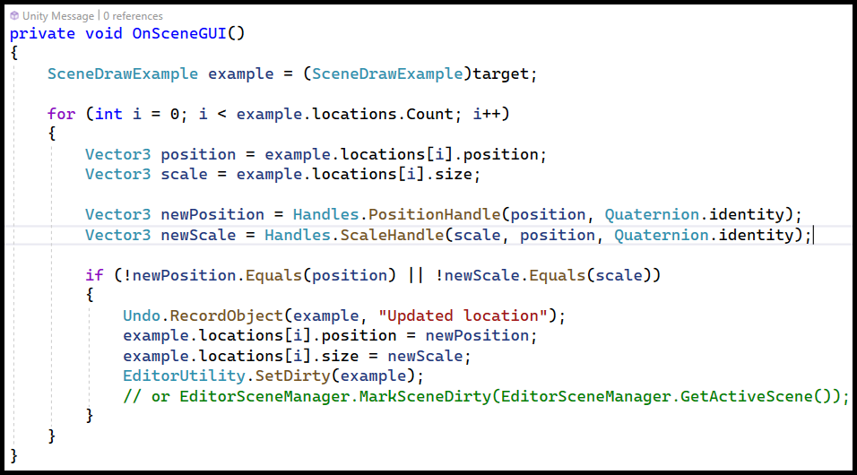
Detecting changes with your own code
By saving the values of the Handles in new variables, we can compare old and new.

Slide 34
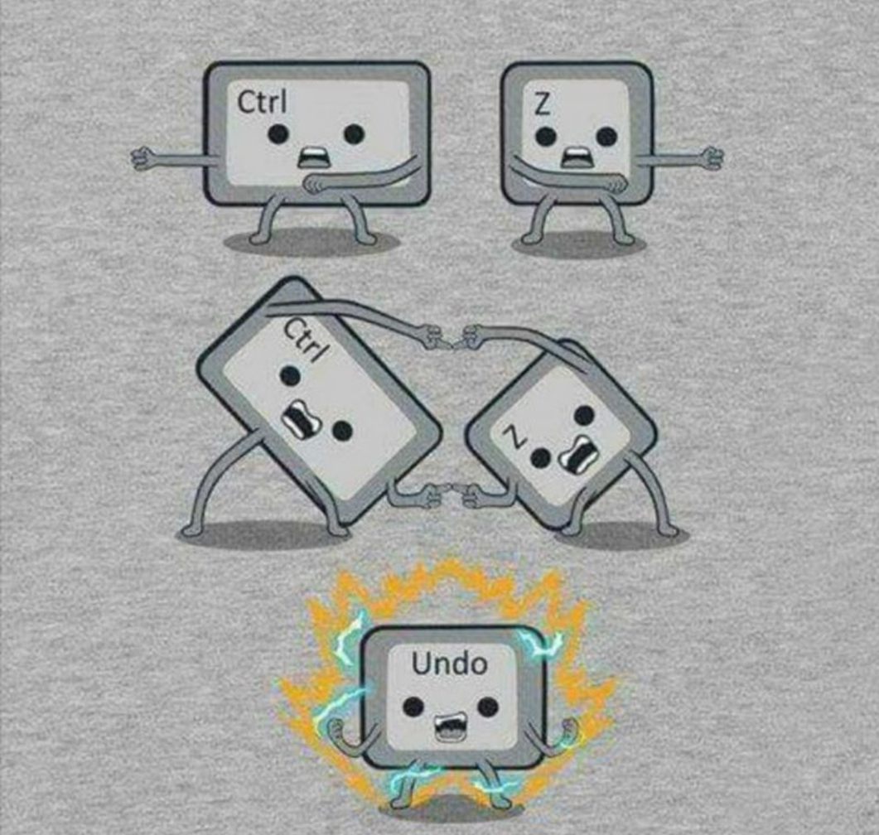
Undo and Redo
Like dirtying the scene, changes are not recorded when we use ‘target’
However, we can tell Unity to record them… if we do it correctly
Pay close attention to which object you should record
And where to place it in your code
Some Undo calls should be called before making changes, some after
And some… should happen in the SAME function call :O
Reference: Undo
Notes:
Use SceneDrawingExampleEditor again

Slide 35
Undo and Redo
We only need to record an undoable operation when a change was made.
In this case, we want to record an operation performed on an object, our SceneDrawExample.
Depending on the operation, different functions apply.

Slide 36
Exercise
Make exercise 1.2
Draw PositionHandles at the position of each element of the ‘points’ list. Make sure they update the position when dragged.
The scene should be marked dirty if one of the following actions occurs:
One of the PositionHandles is used
A new point is added to the ‘points’ list as a result of spacebar being pressed (the code already adds the point)
Both actions should be undoable
BONUS: automatically call ‘Apply’ on the Curve object after one of these actions AND after these actions are undone/redone (just in case you happen to use events for this: make sure you don’t subscribe more often than necessary)

Slide 37
Editor Scripting Part 3
An alternative to ‘target’
The Event system

Slide 38
Confession time
Promise me you won’t get mad
Instead of using ‘target’, you can use SerializedObject
Marks the scene dirty
Records changes for undoing and redoing
This power comes at a price though
It is more complex
More hoops to jump through to do simple stuff
No direct access to the object (without losing the cool stuff)
Notes:
Use Component4 to demo this
There is also commented code in the CurveEditor in the addPoint method that uses serializedObject instead of target

Slide 39
Events
!!This is not about C# events, but Unity’s Event class!!
Instead of updating every frame, the Editor only updates after certain events happen
Two types
User input
Keyboard
Mouse
GUIEvents
Layout; calculates the position of GUI elements
Repaint; draws all GUI elements
This means our GUI callbacks (OnInspectorGUI, OnSceneGUI, OnGUI) are sometimes very often, sometimes not at all

Slide 40
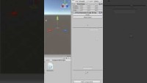

Slide 41
Responding to user input
We can check which event is causing our methods to be called with Event.current
The event holds additional information like which key/mouse button has been pressed
Remember: no Update(), so we can’t use the Input class
The KeyDown event behaves differently than expected
Input.KeyDown responds only once, until you release the key
The KeyDown event can trigger multiple times
It follows your system settings for key delay and key repeat rate
When using input that is already linked to a different functionality, we might want that to not happen
Examples:
Pressing the spacebar spawns a menu in the scene
Pressing W switches the current tool to PositionHandles
Event.Use to the rescue!
‘Using’ it makes sure nothing else responds to this event
Sets the type to Used
Can be quite dangerous, so use with care!
Notes:
Use Component5 to demo using events and how to catch keyboard/mouse input
Maybe also good to show how often/not often GUI methods are called

Slide 42
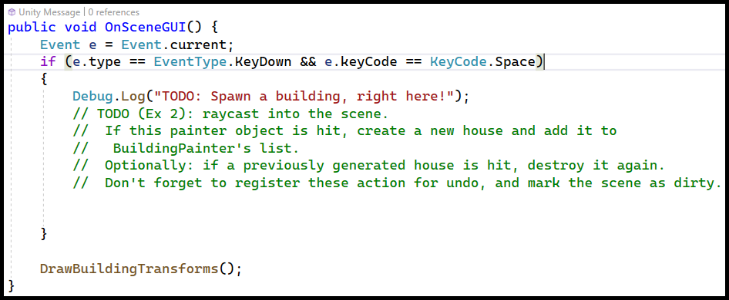
Events example
First we save the current event. Remember that this could be many different things
Then we check which event it is. If it is a KeyDown event we execute a bit of code, otherwise we ignore it.

Slide 43
Exercise
Make exercise 2
Open the BuildingPainter scene. The BuildingPainter object has a script attached to it: BuildingPainter. Open the BuildingPainterEditor script and add the following functionality to it:
When spacebar is pressed while the mouse is over the plane, a building should be placed (for now just a Block prefab).
Spacebar shouldn’t spawn any annoying context menus when placing a building.
Placing a building should mark the scene dirty. This action should be undoable.
Bonus:
Display a TransformHandle for each building. You should be able to control the building’s position, rotation and scale with it.
Come up with a user-friendly way to delete buildings and implement it.
As you might expect, these actions should all be undoable and mark the scene as dirty. ☺
Notes:
Current implementation of deletion is actually not that user-friendly imo, I should probably fix that
This exercise is in the BuildingPainterScene
Adding a building to the scene automatically marks it dirty, let’s see if students realize that.
Students are free to try using serializedObject, but target is recommended.

Slide 44
Editor Scripting 4
WaypointManager Demo
Recommended resources
Final questions?

Slide 45
WaypointManager
With all the knowledge you gained today, you should be able to make a basic WaypointManager
List Vector3s
Drawing lines between them
Moving them through PositionHandles
Interesting to investigate if you have the basics:
Spline editor
Basically moving a bunch of V3s around, which we already can
Doing some cool math using them
Add for info (maybe waitTime?) to each Waypoint
Requires displaying Waypoints differently
CustomPropertyDrawer? System.Serializable?
Defining different paths for the same agent
… the sky is the limit
Notes:
The Waypoint Manager can be demoed with the WaypointAgent in the BuildingPainterScene
The Waypoint editor is quite buggy currently, I haven’t had the time to fix it yet. The basics work tho.
There is currently no demo (that I know of) for showcasing a spline editor or having multiple paths for the same object

Slide 46
Some tutorials & references (... but only a small part ...) 1
Lots of Hans’ work (see Blackboard)
Examples from this lecture
Editor Scripting cookbook
Bunny83’s Editor scripting crash course
Attributes; there are a lot of useful ones
SerializeField, HideInInspector, Range, Header, Space, Tooltip, RequireComponent, System.Serializable, CreateAssetMenu, MenuItem…
Just google ‘handy attributes Unity’
Unity manual:
https://docs.unity3d.com/Manual/ExtendingTheEditor.html
https://docs.unity3d.com/ScriptReference/EditorWindow.html
https://docs.unity3d.com/Manual/JSONSerialization.html
https://docs.unity3d.com/Manual/class-ScriptableObject.html
...and much much more (basically any keyword/method call that you see in the code)
Notes:
Component6 can be used to showcase HideInInspector and System.Serializable if you want

Slide 47
Some tutorials & references (... but only a small part ...) 2
Tutorials:
Keep in mind some of the tutorials use outdated/cumbersome approaches here and there
https://learn.unity.com/tutorial/editor-scripting
https://learn.unity.com/tutorial/introduction-to-editor-scripting
https://learn.unity.com/tutorial/scripting-custom-editor-windows-and-inspectors
https://learn.unity.com/tutorial/introduction-to-scriptable-objects
https://www.patrykgalach.com/2019/09/12/custom-scriptable-wizard/
https://medium.com/@prasetion/saving-data-as-json-in-unity-4419042d1334
https://www.youtube.com/watch?v=aPXvoWVabPY (Brackeys scriptable objects)
Your friendly teachers ☺

Slide 48
